Slide 1
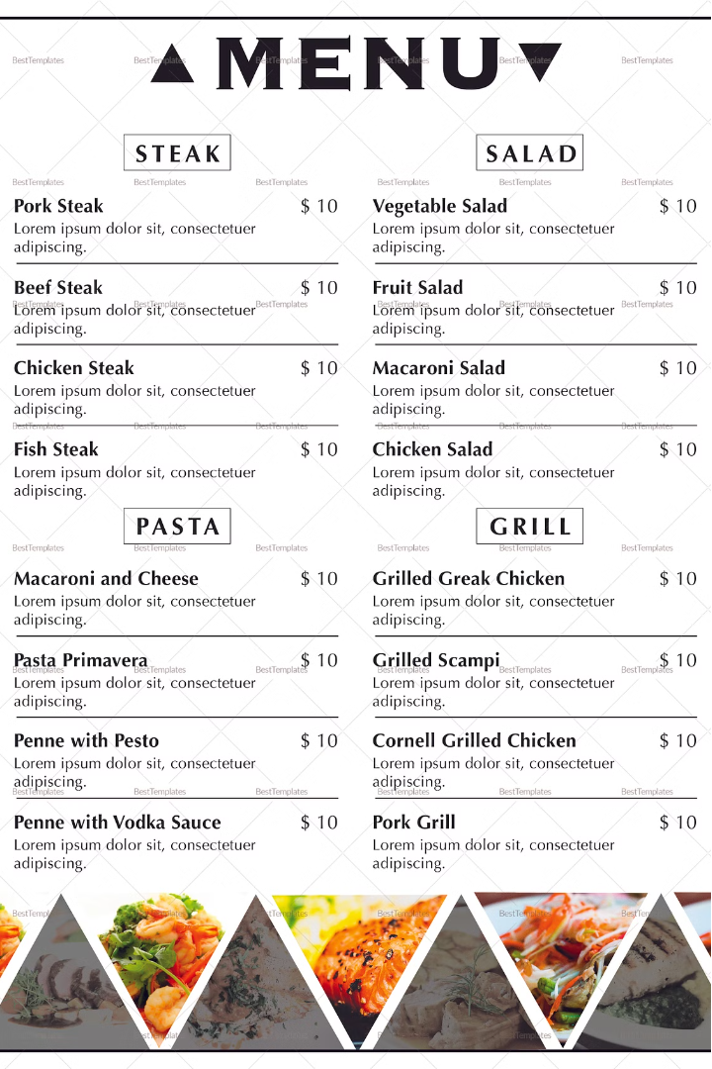

Food Ordering System
This Python-based food ordering system streamlines the process of finding, selecting, and ordering delicious meals at your fingertips. From user authentication to managing restaurant options and customizing orders, this efficient system simplifies the dining experience.

Slide 2
Login Page
Username
Password
Login
Enter your registered username to access the system.
Securely enter your password to authenticate your account.
Click the login button to proceed to the next step.

Slide 3
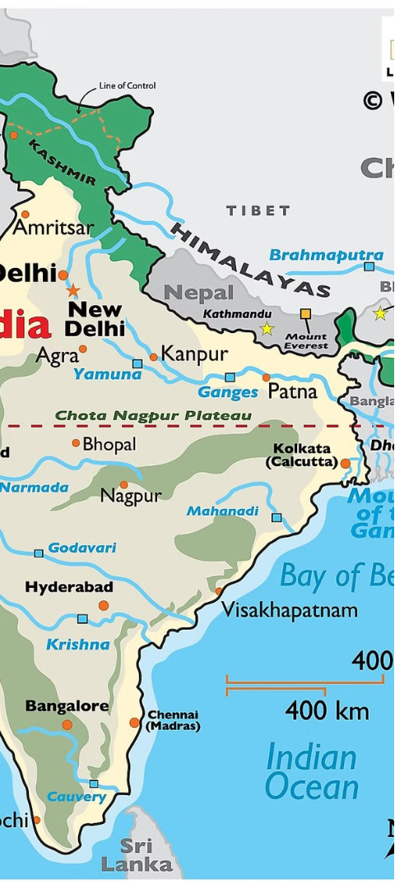
Locations
1
Warangal
2
Hanmakonda
Explore a wide range of dining options in the vibrant city of Warangal.
Discover the culinary delights of the historic town of Hanmakonda.
3
Kazipet
Savor the local flavors and specialties in the bustling city of Kazipet.

Slide 4
Available Restaurants
Spice Hub
Foodies
Authentic Indian cuisine with a modern twist.
Vegetarian and vegan options in a cozy setting.
Taste Town
Featuring a wide array of freshly prapared sushi.

Slide 5

Restaurant Menu
Spicy Hub
1
Pizza and Burger.
2
Foodies
Sandwich and Pasta
Taste Town
3
Tacos and Sushi.

Slide 6




Add Items to Cart
Add to Cart
Quantity
Total
Proceed
Select your desired items and add them to your order.
Adjust the quantity of each item to match your preferences.
View the total cost of your order before proceeding to checkout.
Click the checkout button to finalize your order.

Slide 7



Cancel Order
View Cart
Confirm Cancellation
Carefully review the items in your cart before deciding to cancel.
Confirm your decision to cancel the order to proceed.

Slide 8
Key Features
CRUD
Create, Read, Update, and Delete operations for managing orders and user data.
Abstraction
Simplify complex processes by providing a high-level interface for users to interact with the system.
Encapsulation
Protect sensitive information and data integrity by encapsulating functionality within the system.

Slide 9
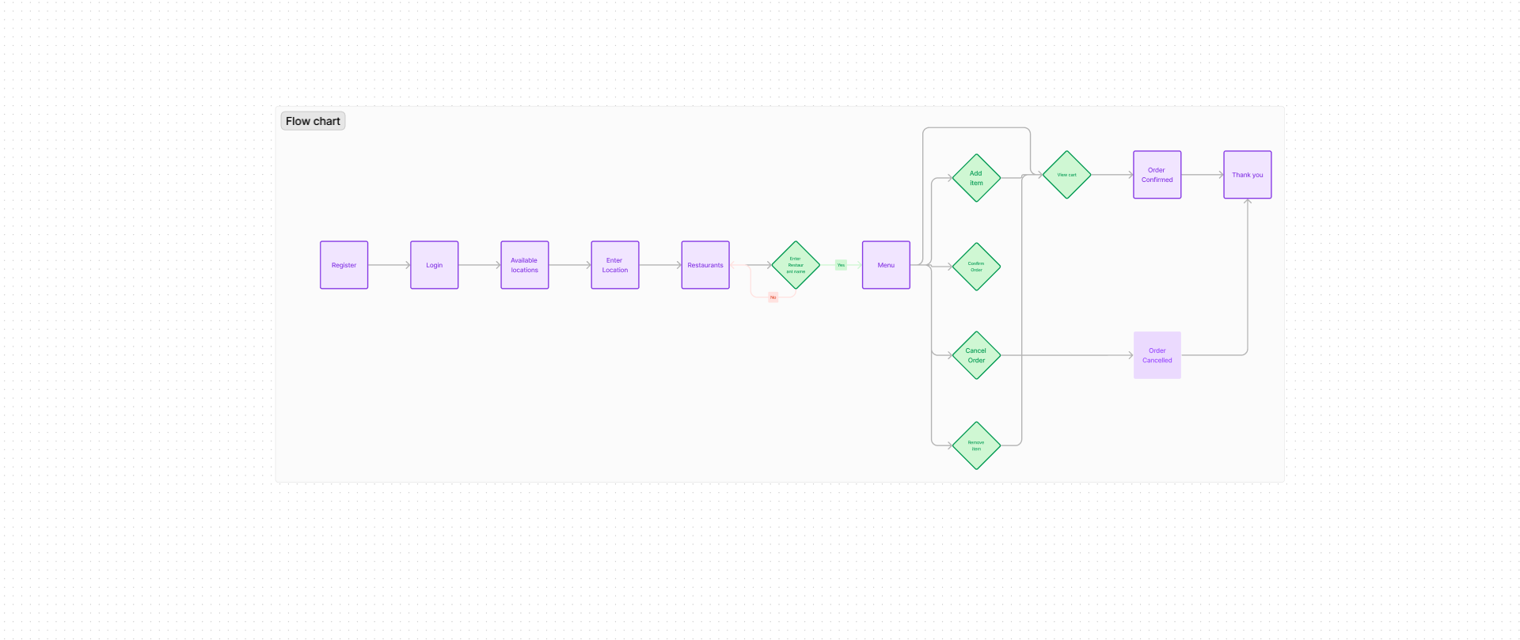

Slide 10
THANK YOU

